Slide 1


How to publish genomic Data papers based on BOL data - Biodiversity Data Journal
Lyubomir Penev
Bulgarian Academy of Sciences & Pensoft Publishers
ViBRANT Tools for DNA taxonomists,
11 June 2013, Brussels
ViBRANT

Slide 2








Life cycle of data associated with biodiversity manuscripts
Occurrence data
Any other data
Genomic dada
Morphometric data
Biodiversity
manuscript
Phylogenetic data
Image galleries
Environmental
data
XML
MARK UP
Structured text
(data!)
ARTICLES
Biblio-
graphies
Occurr-
ence data
Taxon treatments
Taxon names
Plazi
Wiki
COL
BHL

Slide 3
  The problem ?

Slide 4
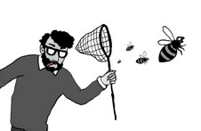
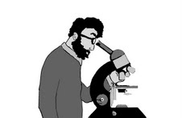

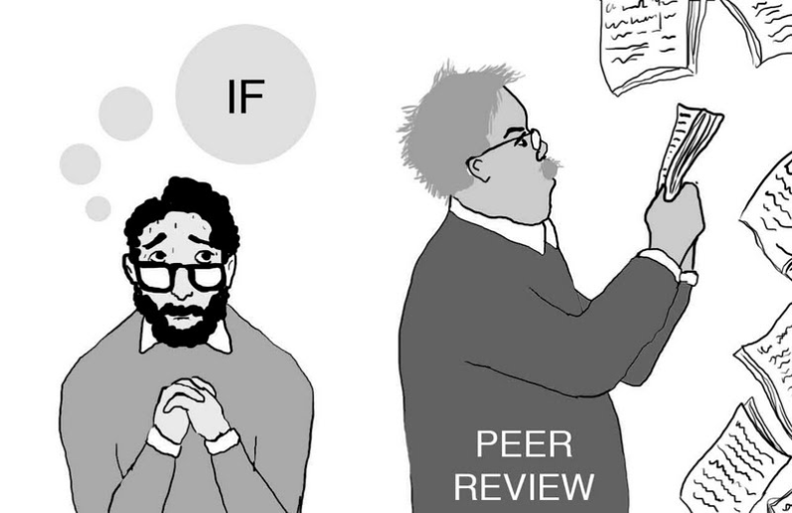
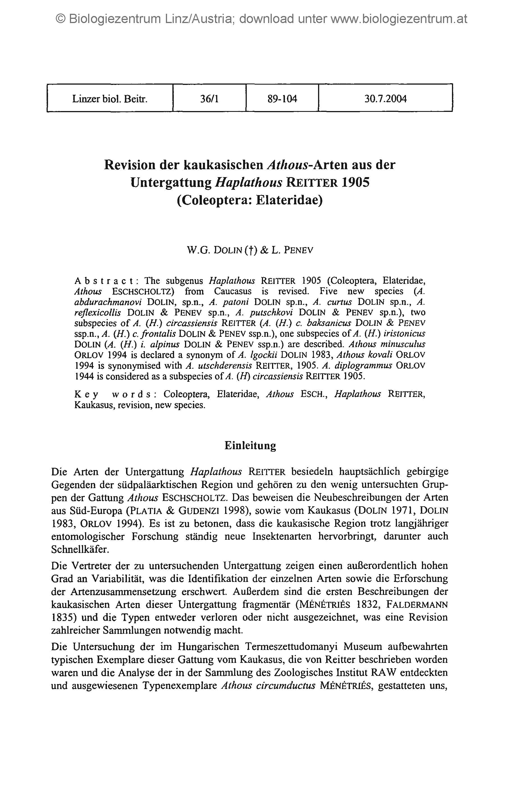




Primary data
Drawings: slavenapeneva.com

Slide 5
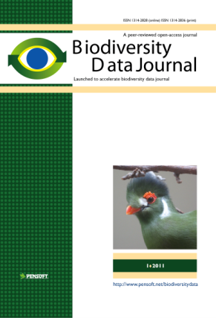
RE-USE
of
CONTENT
Publishing and sharing of primary data
Primary data

Slide 6
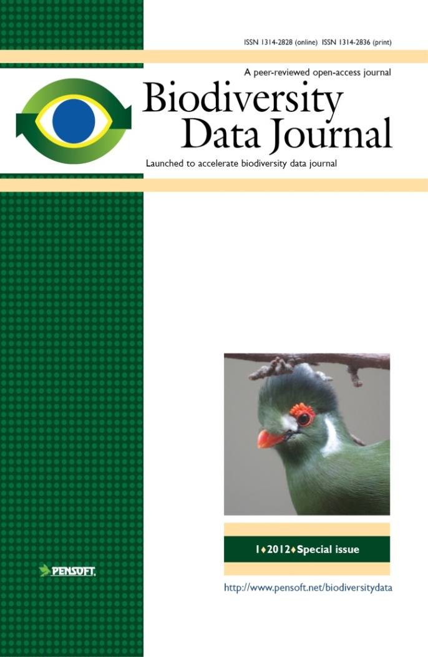
Key features
Collaborative article authoring
Online peer-review and editing
Community peer review; options for “open” and “public” review
Standard-compliant (DwC, NLM DTD)
Biological Codes compliant article templates
No lower/upper limit of manuscript size
Semantically enhanced “articles
of the future”
Integrated with GBIF, EOL, Dryad Scratchpads, etc.
ALL DATA MATTERS!

Slide 7
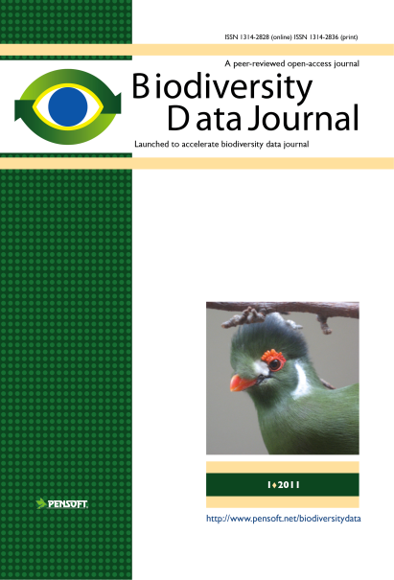

What will BDJ publish?
Single taxon treatments and nomenclatural acts
Local/regional and habitat-based checklists
Sampling reports and occasional inventories
Ecological and biological observations of species and communities
Identification keys
Data papers for any biodiversity-related type of data (genomic, phylogenetic, ecological, environmental, etc.)
Descriptions of biodiversity-related software tools and workflows
Recruiting editors now!
Notes:
7
Slide 12: Next generation article publishing
Arguably our most ambitious developments in the context of scholarly communication concern the semi-automated construction of scholarly papers from databases. In many cases Scratchpads contain extensive data relating to the biology and description of particular species. These are highly suited to formal specialist publications, but doing so require the laborious assembly of these data into a manuscript. As part of the ViBRANT collaboration with Pensoft, and in particular their two journals specialising in the formal taxonomic descriptions of plants and animals, we have developed a 5-step workflow for users to selecting appropriate data from their Scratchpad, adding additional metadata describing this information so that it conforms with the norms of descriptive taxonomic publications, and then finally preview and submit this manuscript to the publisher. From here is goes through a standard peer review process. Review recommendations are then incorporated in to a revised version of the manuscript, which is then sent back to the publisher and simultaneously published on both the Scratchpad and in the publisher’s journal.
In addition to dramatically speeding up the construction of scientific papers, the user has the advantage that firstly the manuscript can be revised and updated and new information comes to light on the Scratchpad, while preserving the original version of the manuscript as part of the scholarly record. In addition the publish extracts relevant information from the submitted database which is them automatically submitted to the specialist data repositories.
So in sum then, these are the four ways in which ViBRANT is facilitation scholarly communication of biodiversity information. 1) Through low cost journal infrastructure; 2) by community web publishing; 3) by biodiversity observation data publishing; and 4) by next generation publishing services producing scholarly articles from databases.

Slide 8
Multiple Data Publishing Model of BDJ
Supplementary data files downloadable from the journals’ website
Data deposited at specialized data repositories (Dryad, Pangaea)
Data published through data repositories but indexed and collated with other data (GenBank, GBIF IPT)
Data published in the form of marked-up and machine-readable text.
Extended use of multimedia and semantic enhancements

Slide 9
Types of genomic data publishing
  Data papers describing genome datasets
  Descriptions of “dark taxa”
  More??

Slide 10
For genomic data let’s build up on:
GBIF-Pensoft workflow for publishing occurrence data: data papers

Slide 11
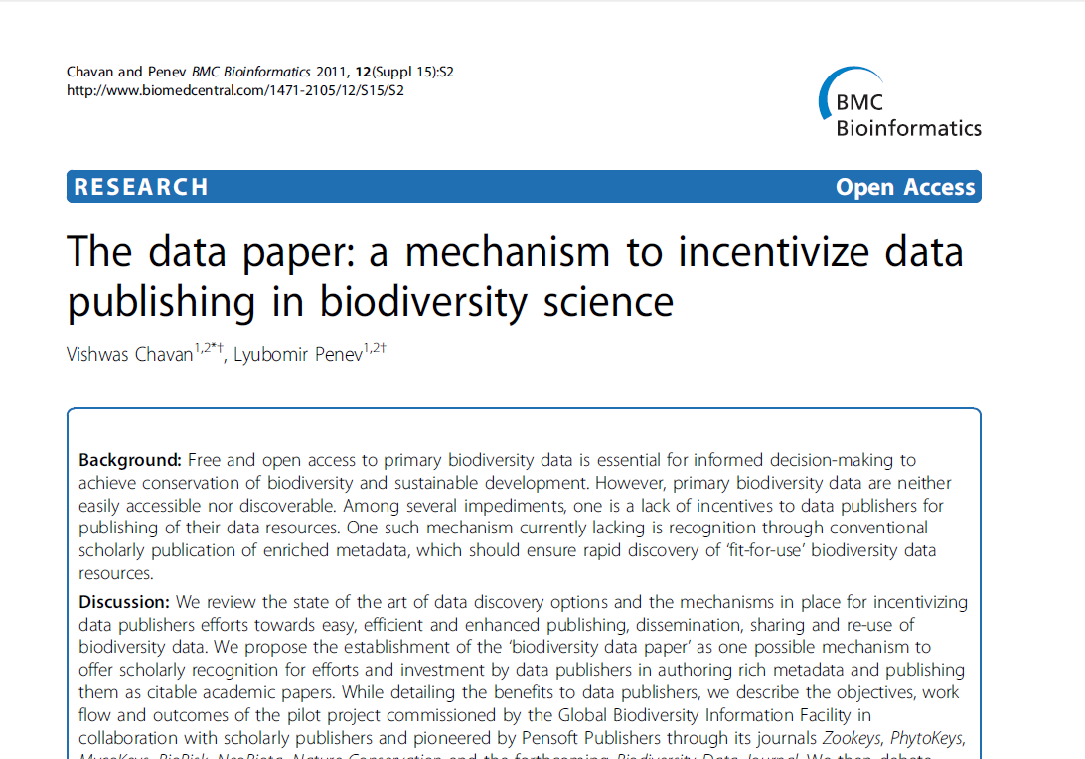
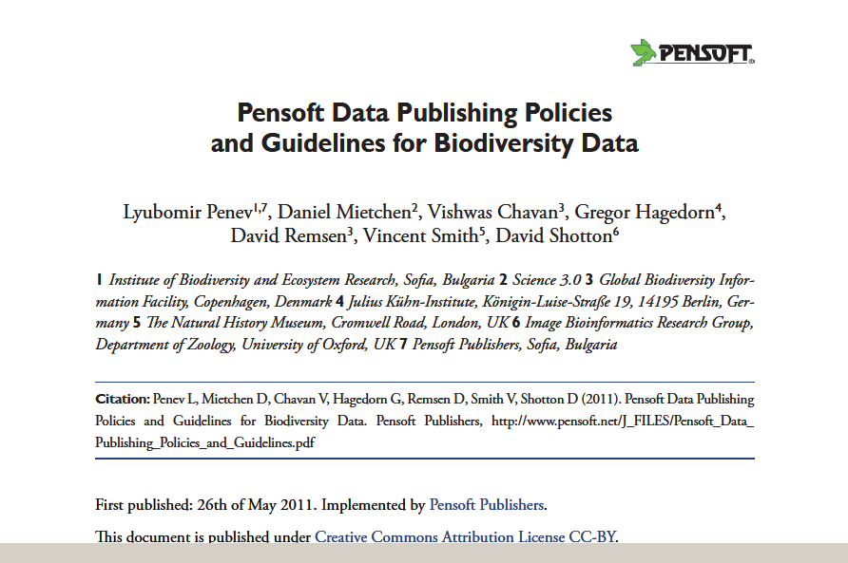
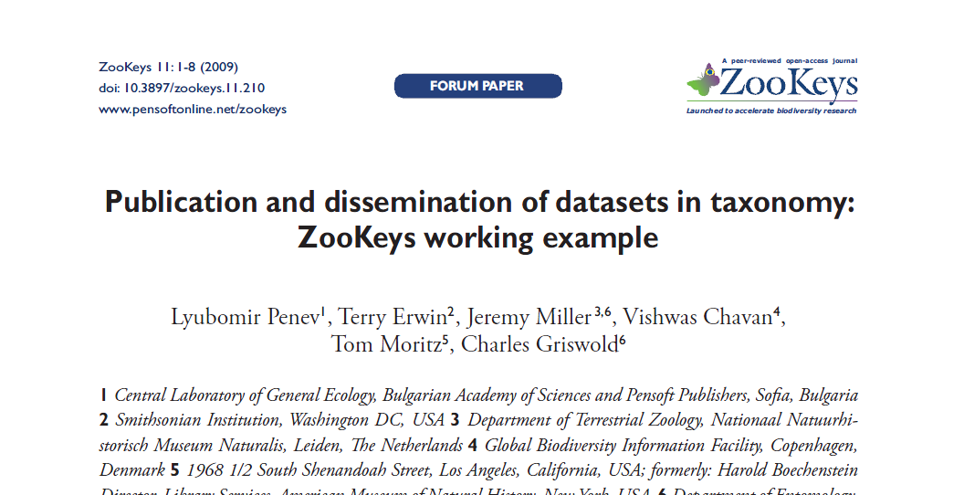

Slide 12
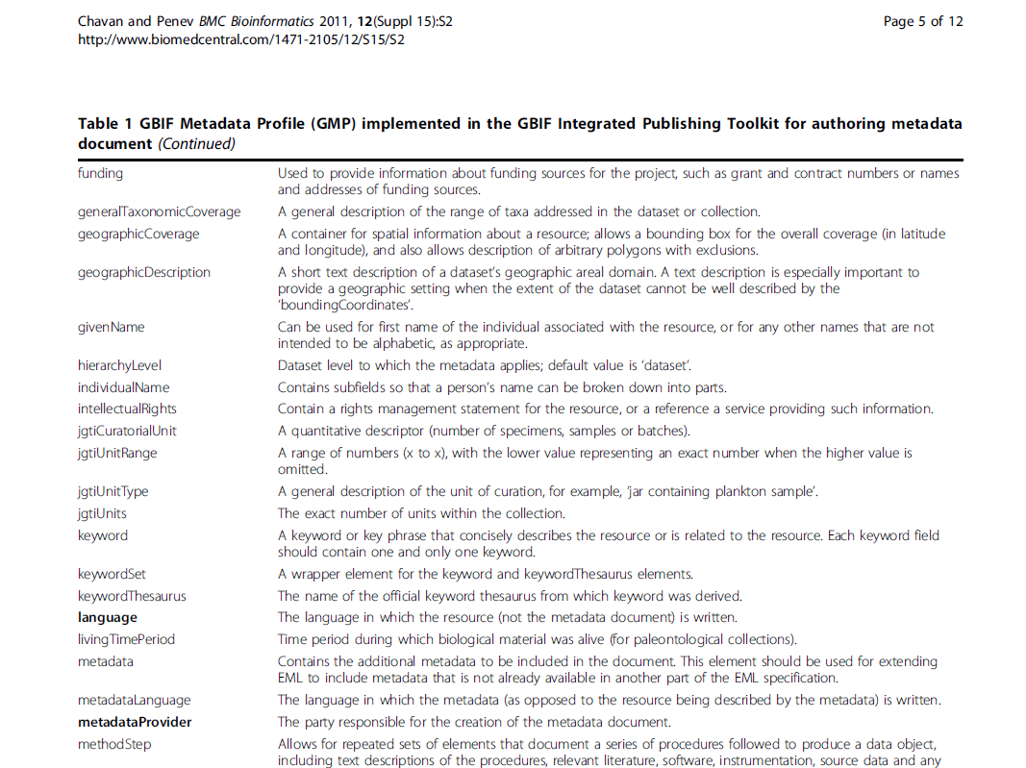
Metadata based on the Ecological Metadata Language (EML)

Slide 13
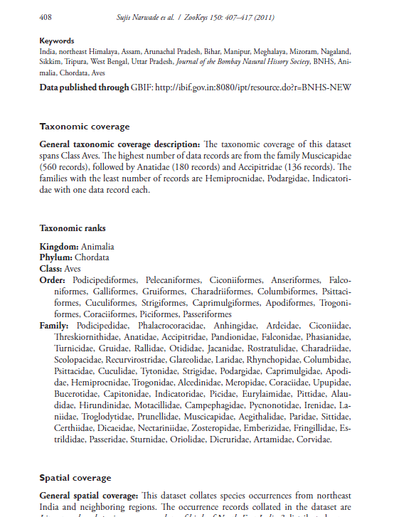
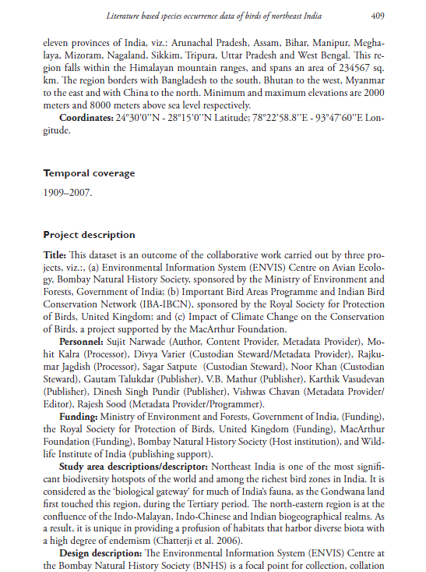
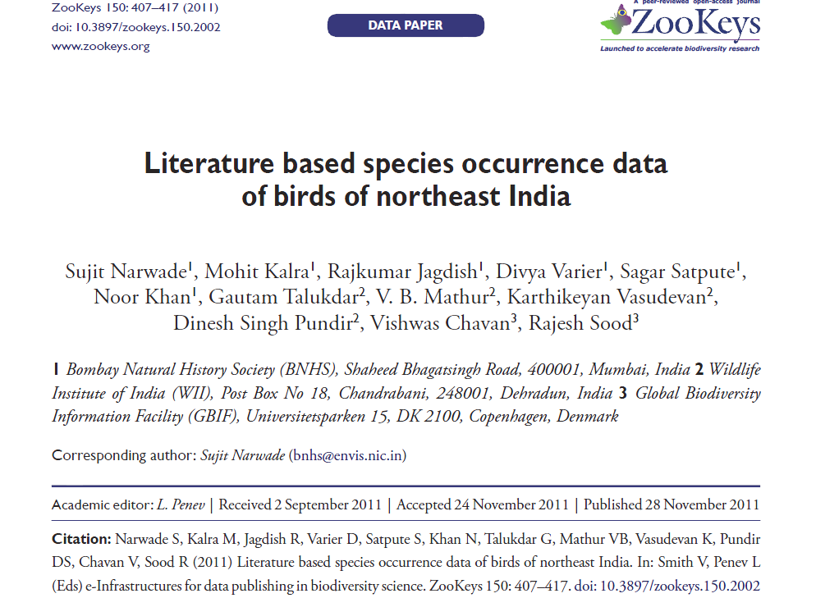
Data publishing through
Data Papers

Slide 14
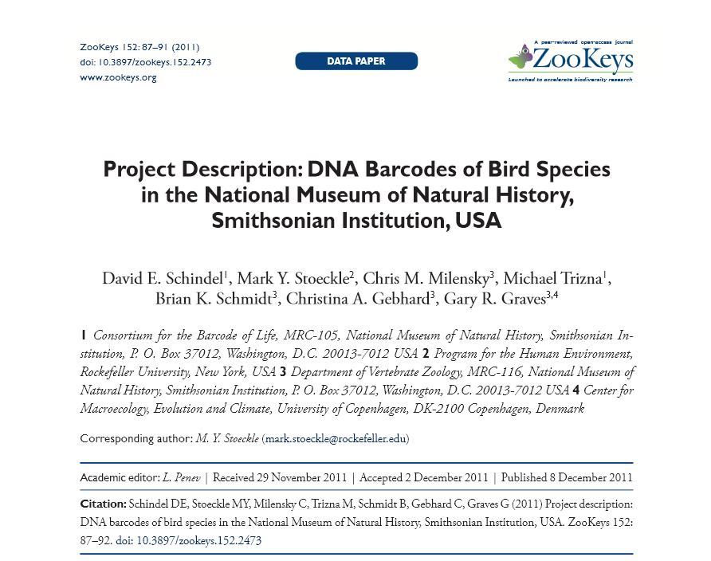

Slide 15
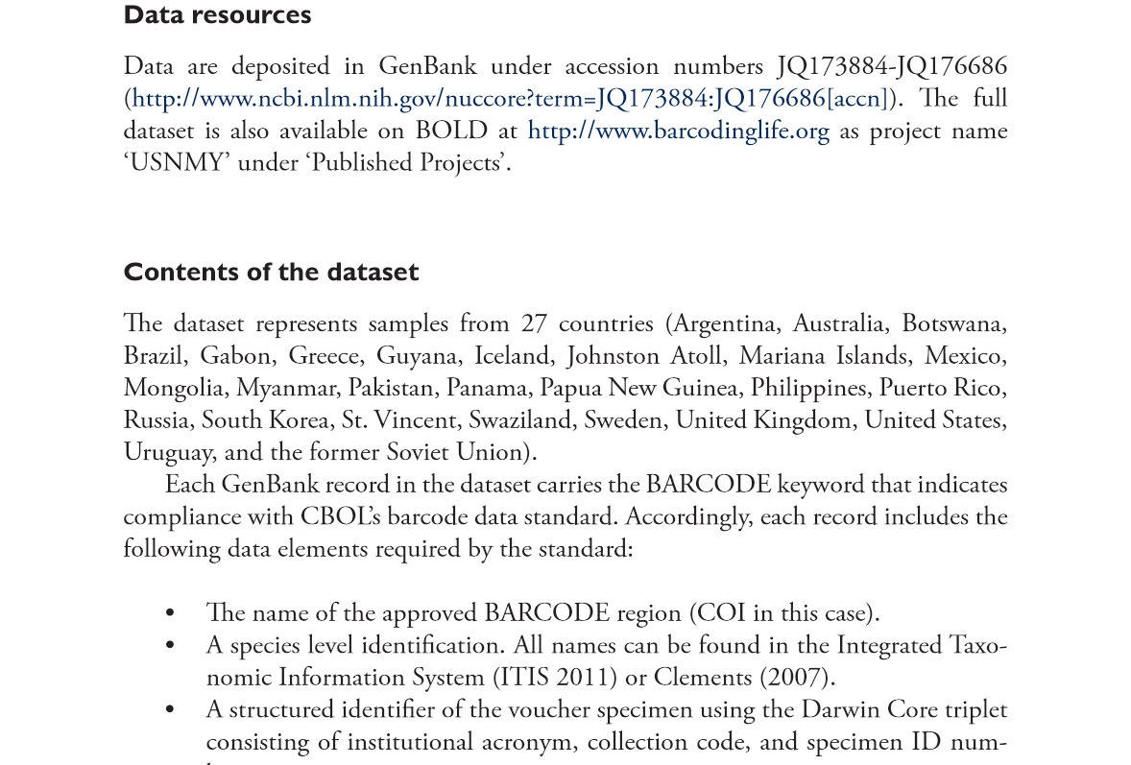

Slide 16
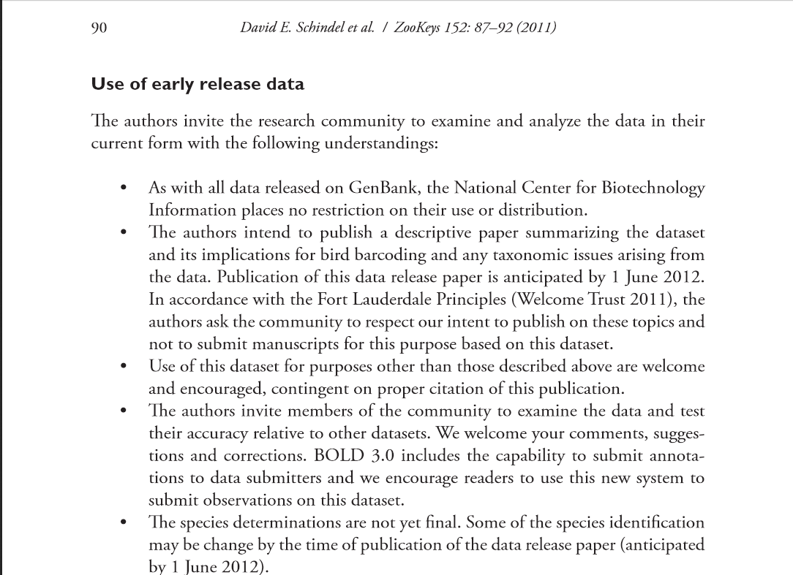

Slide 17
We need to:
Identify the specific metadata descriptors used for genomic data and integrate these into the data paper concept

Slide 18
Then we need to:
Map the existing metadata descriptors for genomic data and automatically generate data paper manuscripts from them

Slide 19
The testbed
ViBRANT special issue:
DNA barcoding: a practical tool for fundamental and applied biodiversity research
Edited b: Zoltan Nagy, Kurt Jordaens, Marc de Meyer, Thierry Backeljau

Slide 20
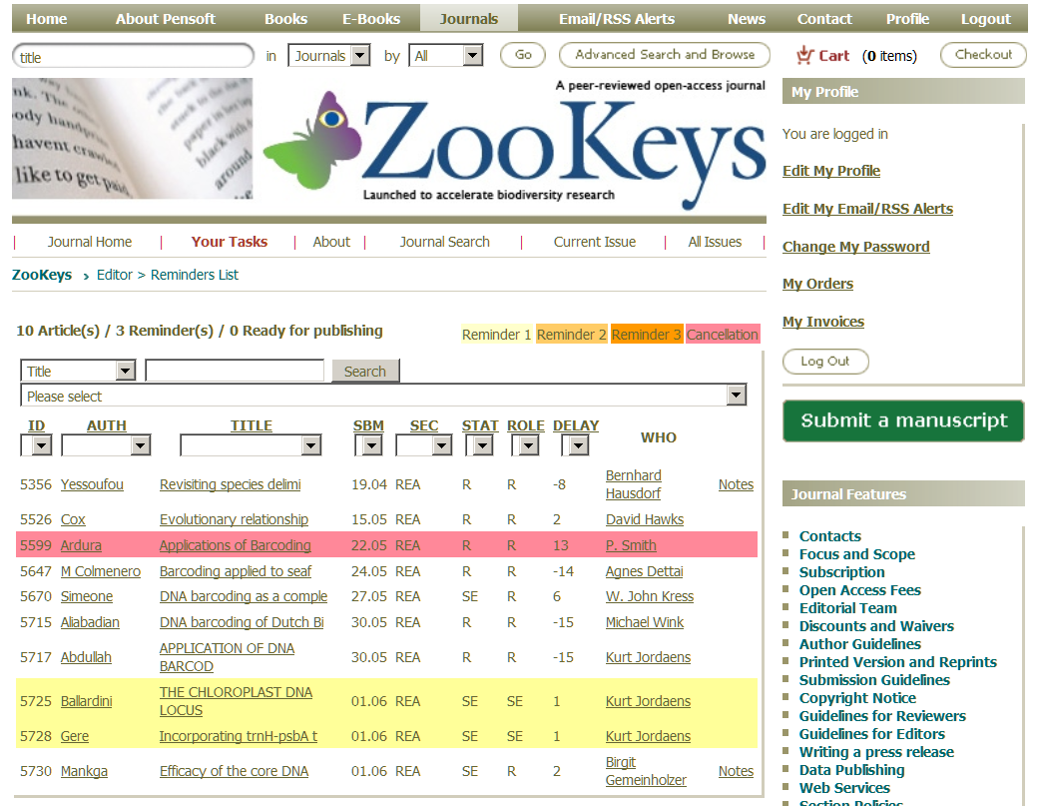

Slide 21
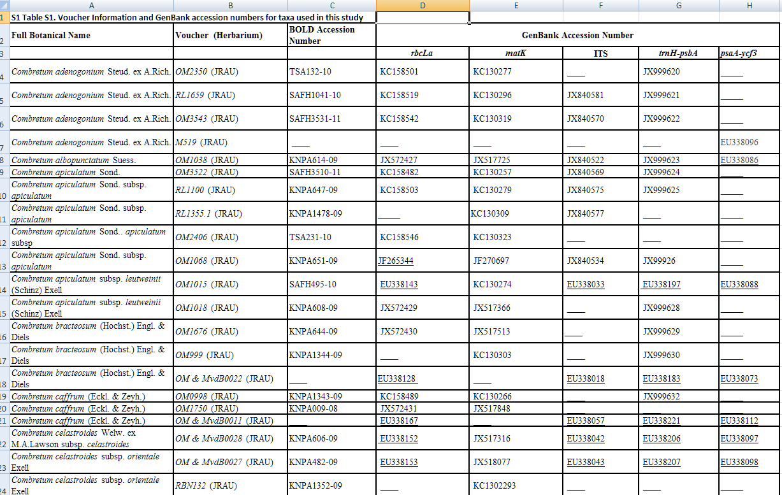

Slide 22
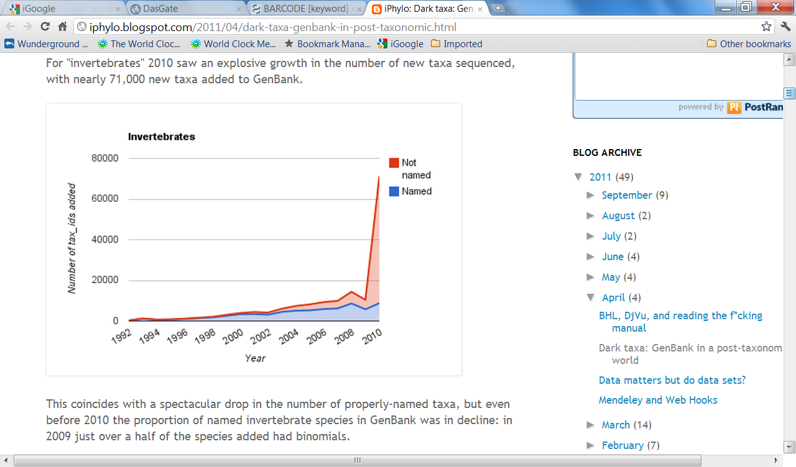
Rod Page’s ‘Dark Taxa’:
R. Page, iPhylo blogspot, 12 April 2011

Slide 23
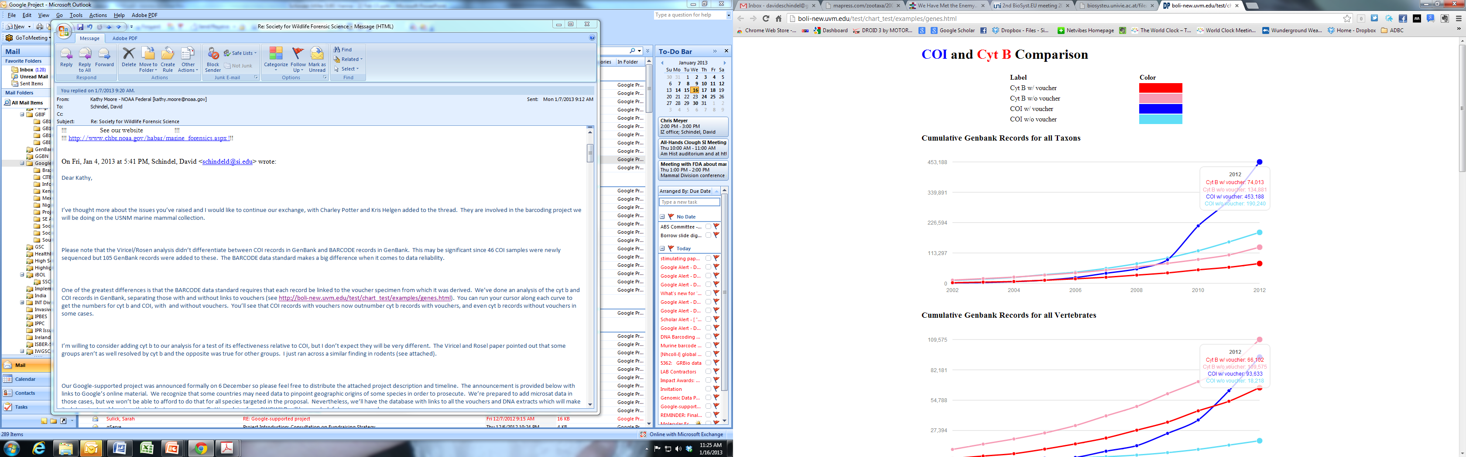
Cumulative Records in GenBank
Growth of COI BARCODE vs. Cyt B, all taxa
Courtesy: David Schindel

Slide 24
BARCODE Records
Specimen Metadata
Voucher Specimen
Species Name
Georeference
Habitat
Character sets
Images
Behavior
Other genes
Indices
- Catalogue of Life
- GBIF/ECAT
Nomenclators
- Zoo Record
- IPNI
- NameBank
Publication links
- New species
Barcode Sequence
Other Databases
Trace files
Primers
Literature
(link to content or citation)
Phylogenetic
Pop’n Genetics
Ecological
Databases
- Provisional sp.
Notes:
The BARCODE data standard: Developed over an 18-month consensus-building process and accepted by GenBank, EMBL and DDBJ. Database records that meet this standard have the reserved keyword BARCODE. The standard requires linkage to a voucher specimen, a known species name, primer sequences, and trace files.

Slide 25
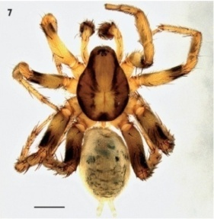
Description of “dark” taxa
Dark taxon sequenced
Pwt – collaborative
article authoring tool
manuscript finaliSation
&SUBMISSION
Automated submission to Pensoft Writing Tool
Bdj – peer-review
Metadata:
voucher specimen,
images, locality, etc.
MANUSCRIPT
PUBLISHED
Automated update of bibliographic metadata, taxon name, Zoobank record, etc.

Slide 26
Reverse Taxonomy
Taxonomic Units:
Clusters, OTUs
Nomenclatural Precedence
Formal Names
(sometimes, with varying certainty)
Diagnostic characters of Study Specimens:
Traits, Sequences
Diagnostic characters In Reference Databases:
GenBank, MorphBank
Courtesy: David Schindel

Slide 27
We have
Some tools and workflows for that…

Slide 28
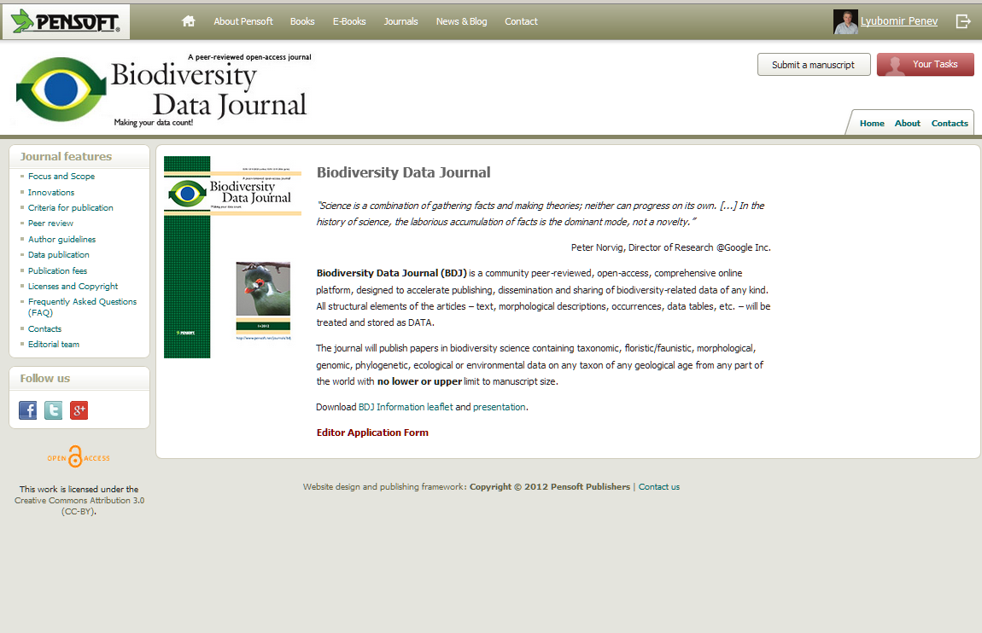

Slide 29

Workflow
Collaborative
ARTICLE AUTHORING
(PENSOFT WRITING
TOOL)
XML submission
Community peer-review
(options for public and
Open review)
ALL ONLINE!
Revisions
online
Authors, Reviewers, Editors, Mentors, Copyeditors
MANUSCRIPT published
XML text + data
ARTICLES
Biblio-
graphies
Occurr-
ence data
Taxon treatments
Taxon names
Plazi
Wiki
COL

Slide 30
Automated submission
Automated XML submission
Notes:
30
Slide 12: Next generation article publishing
Arguably our most ambitious developments in the context of scholarly communication concern the semi-automated construction of scholarly papers from databases. In many cases Scratchpads contain extensive data relating to the biology and description of particular species. These are highly suited to formal specialist publications, but doing so require the laborious assembly of these data into a manuscript. As part of the ViBRANT collaboration with Pensoft, and in particular their two journals specialising in the formal taxonomic descriptions of plants and animals, we have developed a 5-step workflow for users to selecting appropriate data from their Scratchpad, adding additional metadata describing this information so that it conforms with the norms of descriptive taxonomic publications, and then finally preview and submit this manuscript to the publisher. From here is goes through a standard peer review process. Review recommendations are then incorporated in to a revised version of the manuscript, which is then sent back to the publisher and simultaneously published on both the Scratchpad and in the publisher’s journal.
In addition to dramatically speeding up the construction of scientific papers, the user has the advantage that firstly the manuscript can be revised and updated and new information comes to light on the Scratchpad, while preserving the original version of the manuscript as part of the scholarly record. In addition the publish extracts relevant information from the submitted database which is them automatically submitted to the specialist data repositories.
So in sum then, these are the four ways in which ViBRANT is facilitation scholarly communication of biodiversity information. 1) Through low cost journal infrastructure; 2) by community web publishing; 3) by biodiversity observation data publishing; and 4) by next generation publishing services producing scholarly articles from databases.

